Slide 1

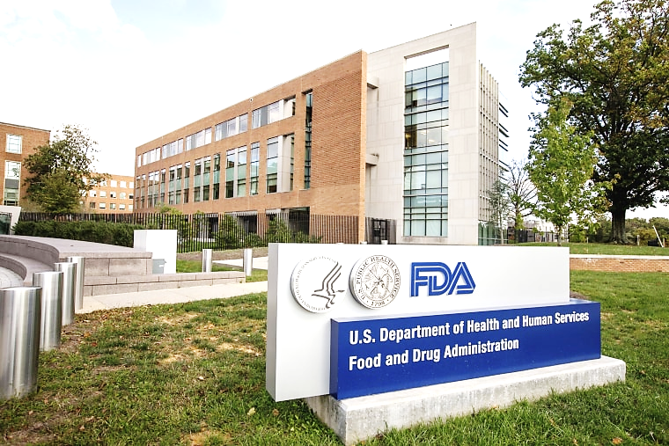
ANALYSIS OF FDA U.S. Food and Drug Administration
DASHBOARD

Slide 2

CRISP-DM
FDA company analyst data by using Cross-Industry Standard Process for Data Mining methodology followed below steps:-
Business Understanding
Data Understanding
Data Preparation
Modeling
Evaluation
Deployment

Slide 3
Business Understanding
Part - 1 SQL Queries
Task 1: Identifying Approval Trends.
Task 2: Segmentation Analysis Based on Drug Marketing Status.
Task 3: Analyzing Products.
Task 4: Exploring Therapeutic Classes and Approval Trends.
Part - 2 Power BI Visualizations
Task 1: Visualize the yearly approval trends of drugs. Highlight any significant patterns and/or fluctuations, if any.
Task 2: Explore approval trends over the years based on different sponsors. Uncover patterns and changes in approval rates among sponsors.
Task 3: Visualize the segmentation of products based on Marketing Status.
Task 4: Show the total number of applications for each Marketing Status. Enable users to filter by years and Marketing Status for detailed analysis.
Task 5: Analyze the grouping of drugs by dosage form. Visualize the distribution of approvals across different forms. Identify the most successful dosage form.
Task 6: Visualize drug approvals based on therapeutic classes. Identify classes with the highest number of approvals.

Slide 4
Data Understanding
After gaining a through understanding of the business requirements, we accessed the data to explore it further, By observing "Data Schema (Draugs@FDA Dataset)" for better understanding a business. These columns description involved in business understanding are as follows:

Slide 5
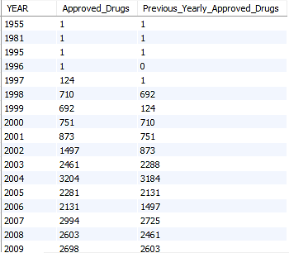
Data Preparation
After completing the phases of business understanding and data understanding, we conducted “Data Preparation”. During this phase, we conduct all four tasks of SQL Queries for completing the project goals are as follows:-
Task 1: Identifying Approval Trends.
1. Determine the number of drugs approved each year and provide insights into the yearly trends.

Slide 6
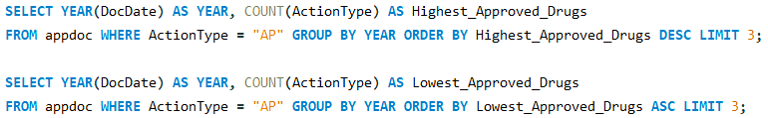
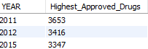
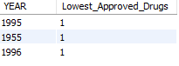
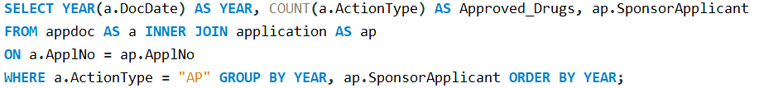
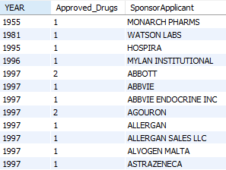
2. Identify the top three years that got the highest and lowest approvals, in descending and ascending order, respectively.
3. Explore approval trends over the years based on sponsors.

Slide 7
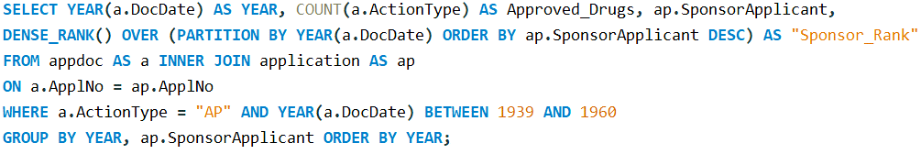
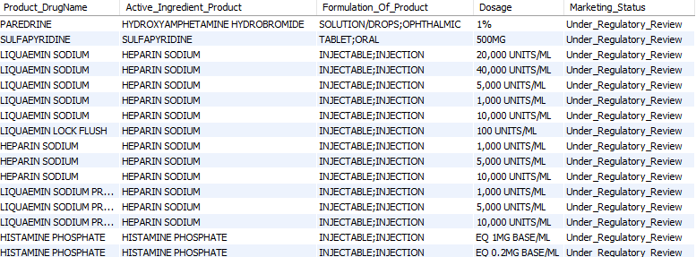
4. Rank sponsors based on the total number of approvals they received each year between 1939 and 1960.
Task 2: Segmentation Analysis Based on Drug Marketing Status.
1. Group products based on Marketing Status. Provide meaningful insights into the segmentation patterns.

Slide 8
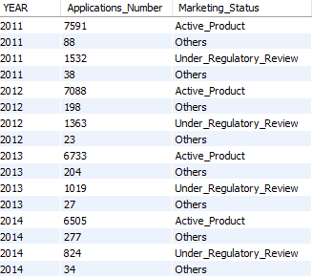
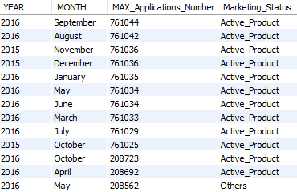
2. Calculate the total number of applications for each Marketing Status year-wise after the year 2010.
3. Identify the top Marketing Status with the maximum number of applications and analyze its trend over time.

Slide 9
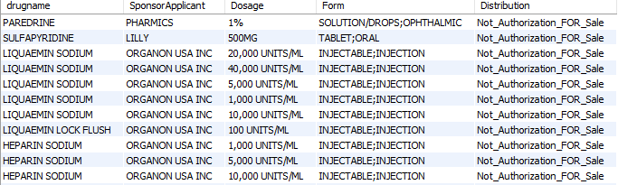
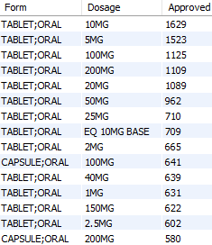
Task 3: Analyzing Products
1. Categorize Products by dosage form and analyze their distribution.
2. Calculate the total number of approvals for each dosage form and identify the most successful forms.

Slide 10
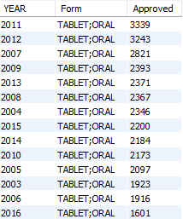
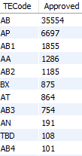
3. Investigate yearly trends related to successful forms.
Task 4: Exploring Therapeutic Classes and Approval Trends
1. Analyze drug approvals based on therapeutic evaluation code (TE_Code).

Slide 11
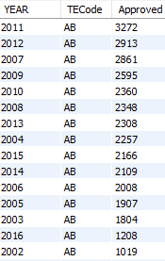
2.Determine the therapeutic evaluation code (TE_Code) with the highest number of Approvals in each year.

Slide 12
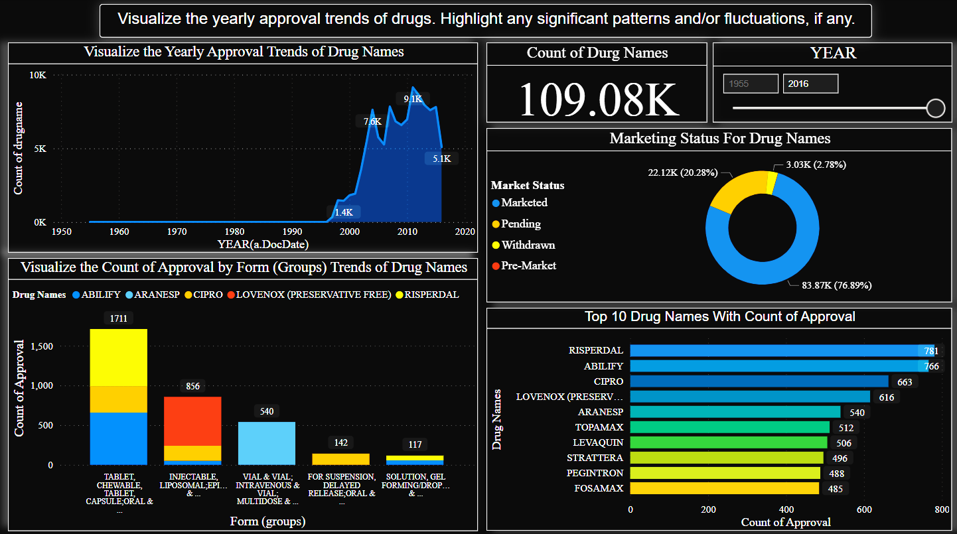
Modeling & Evaluation
In Modeling and Evaluation, during this phase we use Power BI Visualization for filter the data and for better understanding. We are using multiple charts like - line chart, stacked area chart, scatter chart, Donut chart etc. to summarize the data for insights are as follows :-
Visualize the yearly approval trends of drugs. Highlight any significant patterns and/or fluctuations, if any: This graph highlight the Visualize the Yearly Approval Trends of Drug Names, Marketing Status For Drug Names and Top 10 Drug Names With Count of Approval. It could also show Visualize the Count of Approval by Form (Groups) Trends of Drug Names are as given below :-

Slide 13
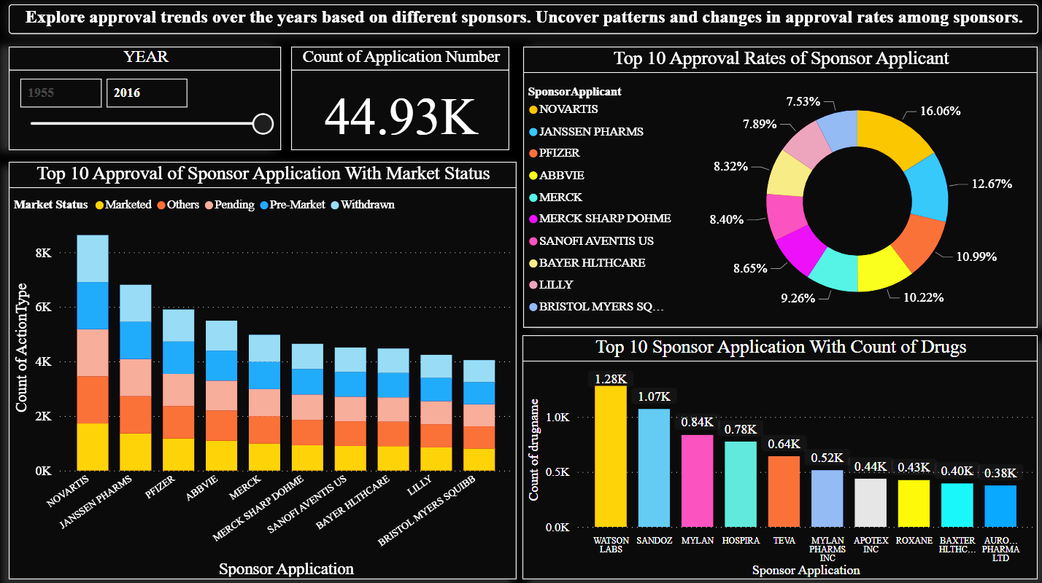
Explore approval trends over the years based on different sponsors. Uncover patterns and changes in approval rates among sponsors: This graph highlight the approval trends of sponsor applicants over the years, the top 10 approval rates of sponsor applicants and applications with market status, and the top 10 sponsor applications with the count of drugs. It could also show the number of action types for each sponsor applicant are as given below :-

Slide 14
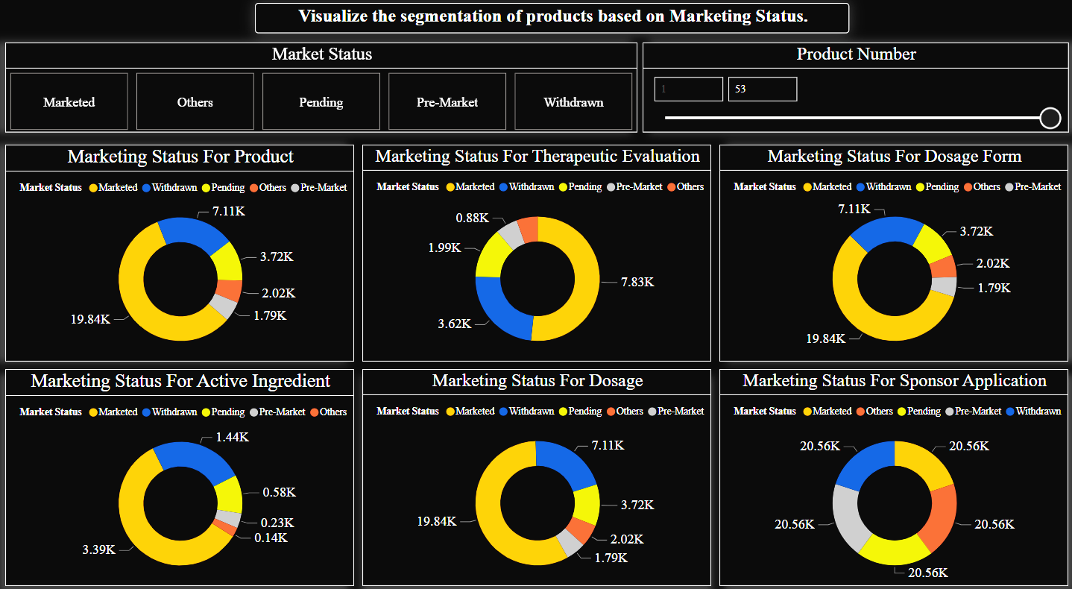
Visualize the segmentation of products based on Marketing Status: The Marketing Status segmented by Products, Therapeutic Evaluation, Dosage Form, Active Ingredient, Dosage, and Sponsor Application. It will help to create a clear and informative graph that highlights the key trends and patterns in the data provided are as given below :-

Slide 15
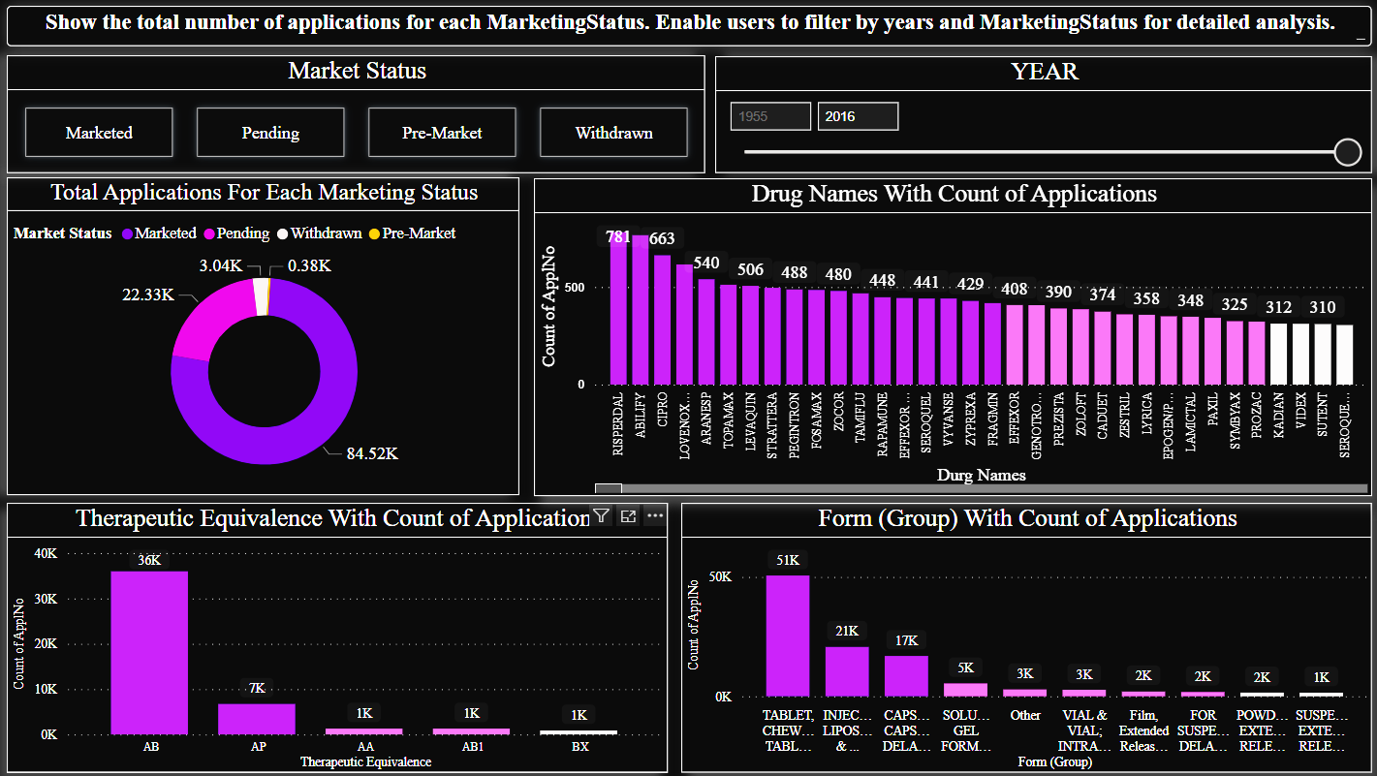
Show the total number of applications for each Marketing Status. Enable users to filter by years and Marketing Status for detailed analysis: This graph highlight the analysis and visualize Total Applications For Each Marketing Status, Drug Names With Count of Applications , and Therapeutic Equivalence With Count of Applications. It could also show Form (Group) With Count of Applications are as given below :-

Slide 16
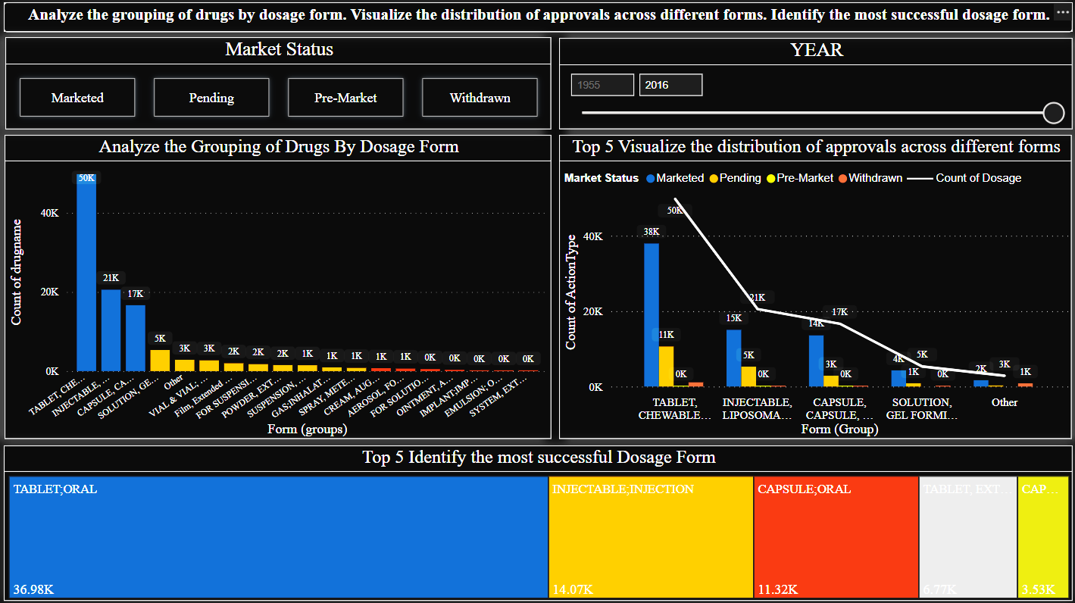
Analyze the grouping of drugs by dosage form. Visualize the distribution of approvals across different forms. Identify the most successful dosage form: This graph highlights the analysis and visualize the count of drugname, count of applno including market status for the groups form and also five mostly successful dosage forms respectively are as follows below:-

Slide 17
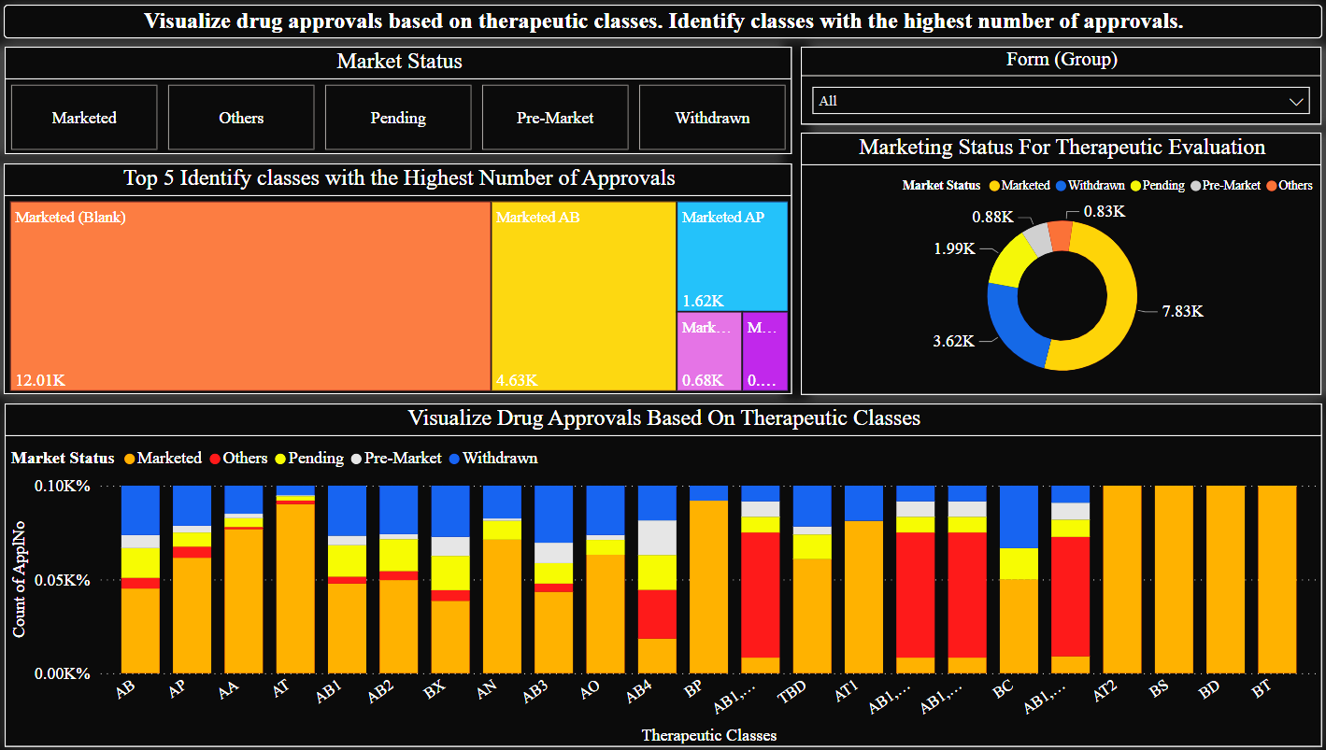
Visualize drug approvals based on therapeutic classes. Identify classes with the highest number of approvals: This graph highlight Marketing Status For Therapeutic Evaluation, Visualize Drug Approvals Based On Therapeutic Classes & Top 5 Identify classes with the Highest Number of Approvals are as given below :-

Slide 18


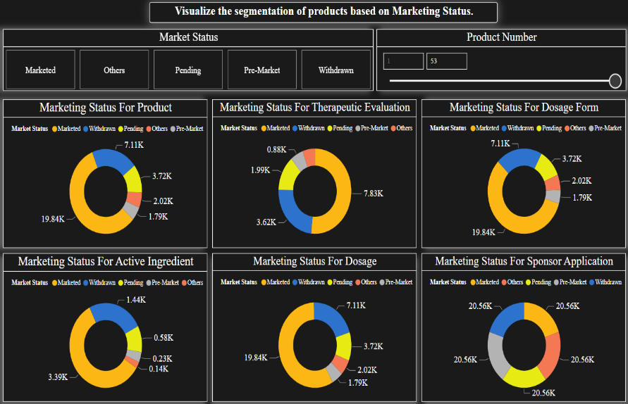


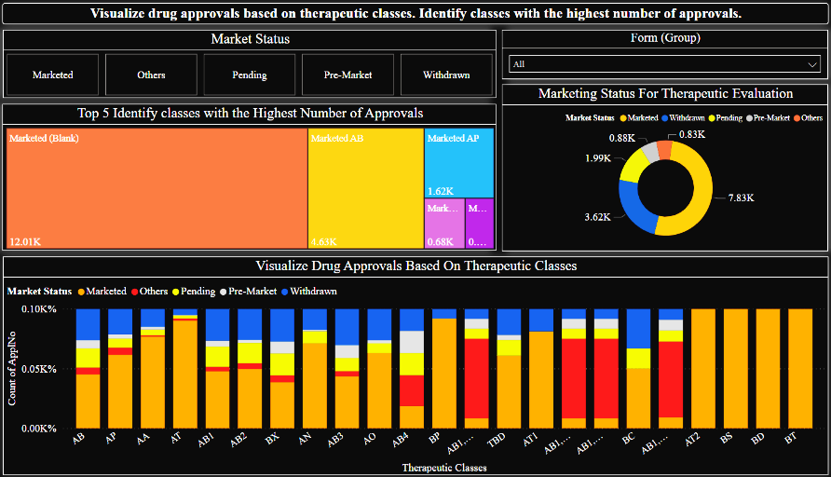
Deployment
By using above Modeling & Evaluation have made an FDA DATA ANALYSIS OF DASHBOARD for a deeper understanding of FDA operations and draw meaningful insights from the data For Real-time monitoring dashboard for tracking all the Project Goals. This will also help to compare different models and identify the best one for the situation.

Slide 19
Recommendations
By observing the above dashboard now, we can recommend FDA as follows :-
Visualize the yearly approval trends of drugs. Highlight any significant patterns and/or fluctuations, if any: A steep increase in drug approvals between 1990 and 2000, followed by a steady increase over the years. There is a slight decrease in approvals between 2010 and 2012.
Explore approval trends over the years based on different sponsors. Uncover patterns and changes in approval rates among sponsors: The sponsors with the highest counts of drugs approved in the given period are: WATSON, SANDOZ, MYLAN, HOSPIRA & TEVA LABS.
Visualize the segmentation of products based on Marketing Status: Focus on the products with a "Pending" status to expedite the marketing process.
Show the total number of applications for each Marketing Status. Enable users to filter by years and Marketing Status for detailed analysis: Enhancing performance and market status of drug products, including their formulation and therapeutic equivalence, is achieved through yearly increments.
Analyze the grouping of drugs by dosage form. Visualize the distribution of approvals across different forms. Identify the most successful dosage form: The most successful dosage form is the 'TABLET, CHEWABLE, CAPSULE; ORAL' group with 8,950 marketed drugs.
Visualize drug approvals based on therapeutic classes. Identify classes with the highest number of approvals: To improve more drug approvals increase the number of drugs that are being approved for unmet medical needs & affordability of drugs.

Slide 20
THANKYOU!

